Slide 1
Rapid Bacteria Detection Using Surface-Enhanced Raman Scattering (SERS)
DMR-1827847
PEAQS NSF PREM 2020 Site visit Virtual Poster Session

Slide 2
Rapid Bacteria Detection Using Surface-Enhanced Raman Scattering (SERS)
DMR-1827847
PHOTO
Dr. Jeff
Jessing
Dr. Yiyan
Li
Keenen
Harvey
Tommy
Swimmer
PEAQS NSF PREM 2020 Site visit Virtual Poster Session

Slide 4
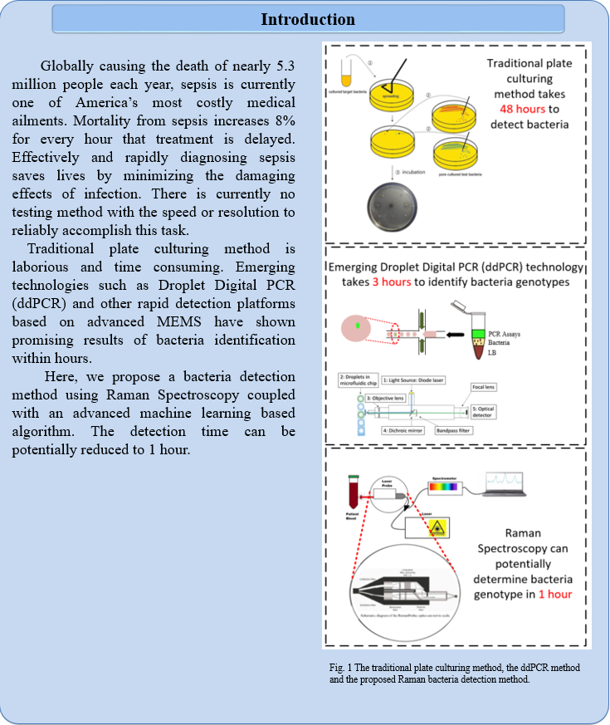
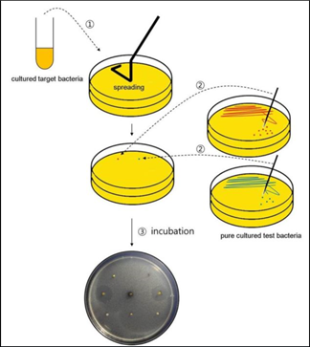
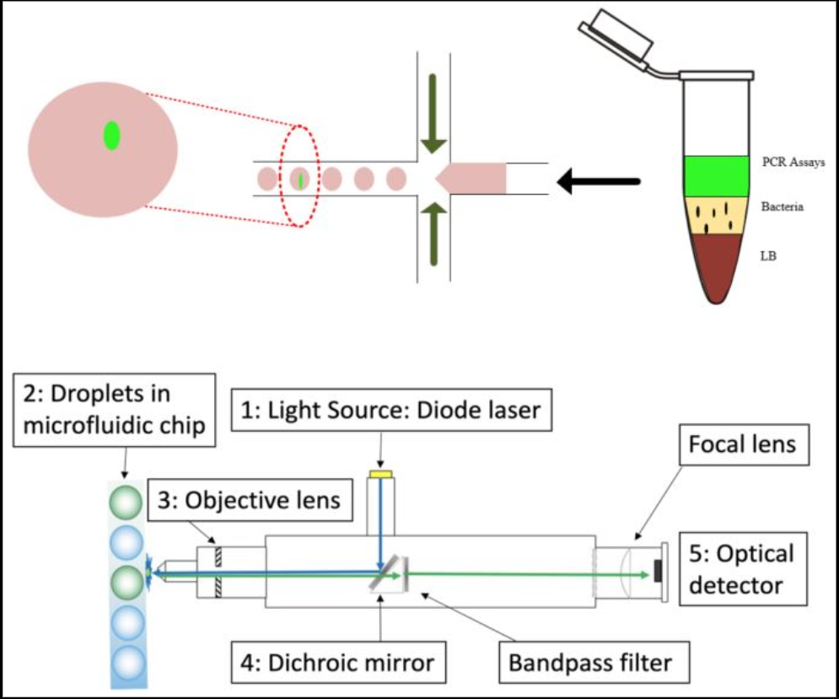

Slide 8
THANK YOU
DMR-1548924
STROBE NSF STC 2020 Site visit Virtual Poster Session

